Slide 1
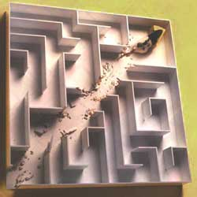
Reinforcement Learning

Slide 2
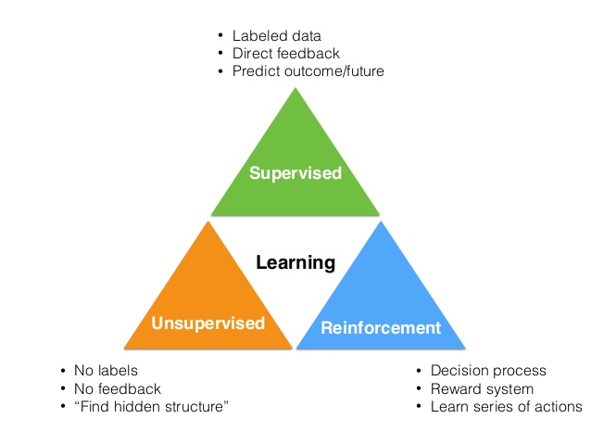
Types of ML

Slide 3
Reinforcement Learning
An approach of AI
Reward based learning
Learning from +ve & –ve reinforcement
Machine learn how to act in a certain environment
To maximize rewards

Slide 4
Critic information
With respect to your past what is your current state

Slide 5
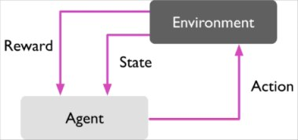
Element of RL

Slide 6
Episode /Trail
Sequence of action from start to terminal state
Policy
State action pair
Finite Horizon
Infinite Horizon

Slide 7
RL algorithms
Q-learning
SARSA (State-Action-Reward-State-Action)
OpenAI Gym library

Slide 8
Applications of RL
Playing the Games like Go/Chess
Robot Control
Online Advertising
Health and Medicine
Education and Training

Slide 9
Disadvantage of RL
Exploration is finding more information about the environment and discovering new actions which can be taken to get more rewards.
Exploitation Trade-off is exploiting known information to maximize the rewards.

